Slide 1

Word Prediction for Text Typing in Telugu
By
M.Durga Prasad,
Computational linguistics,
EFL University.

Slide 2

Abstract
This project is Data Science project
The goal of the Data Science project is to use Natural Language Processing NLP theory , to develop an application that predict the next word for a device user to type in (Next-Word-Prediction).
A dominant technology in Natural Language Processing is called n-grams models and they work well for word prediction.
NLP models, and all models, are as reliable as the data they are trained on is, the n-grams (which are the model features) will be learned from the training data.
In this report I will present the following topics:
Summarize the statistics of the project text data sets.
Describe some data characteristics.
Discuss my plan for developing a prediction algorithm and a shiny app.

Slide 3
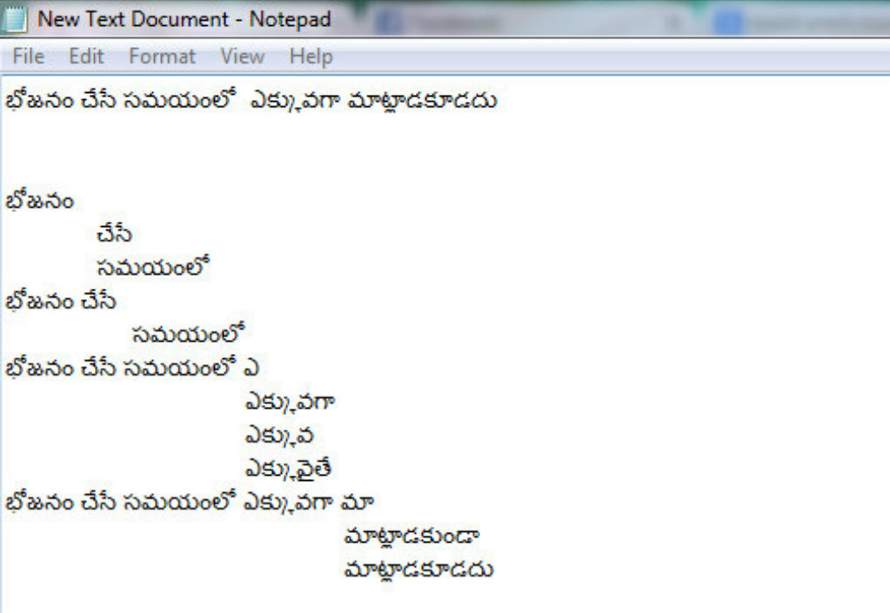
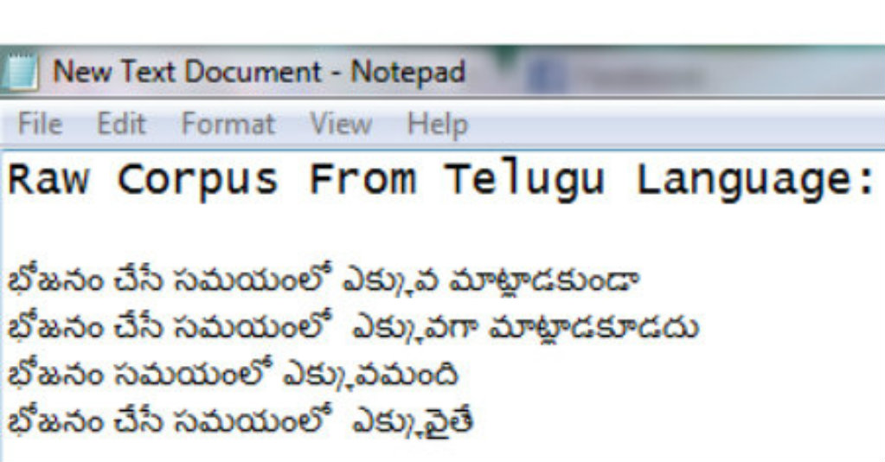
Next word prediction
The task of the project is to build a model to predict the next word based on the previous words entered by the device user

Slide 4
N-grams models of languages
Use the previous N-1 words in a sequence to predict the next word
Language Model (LM)
unigrams, bigrams, trigrams,…
How do we train these models?
very large corpora
corpora:
Corpora are online collections of text data from sakshi(Telugu text).

Slide 5
Packages:
tm
Rweka
Stringi
Knitr
SnowballC
wordcloud

Slide 6
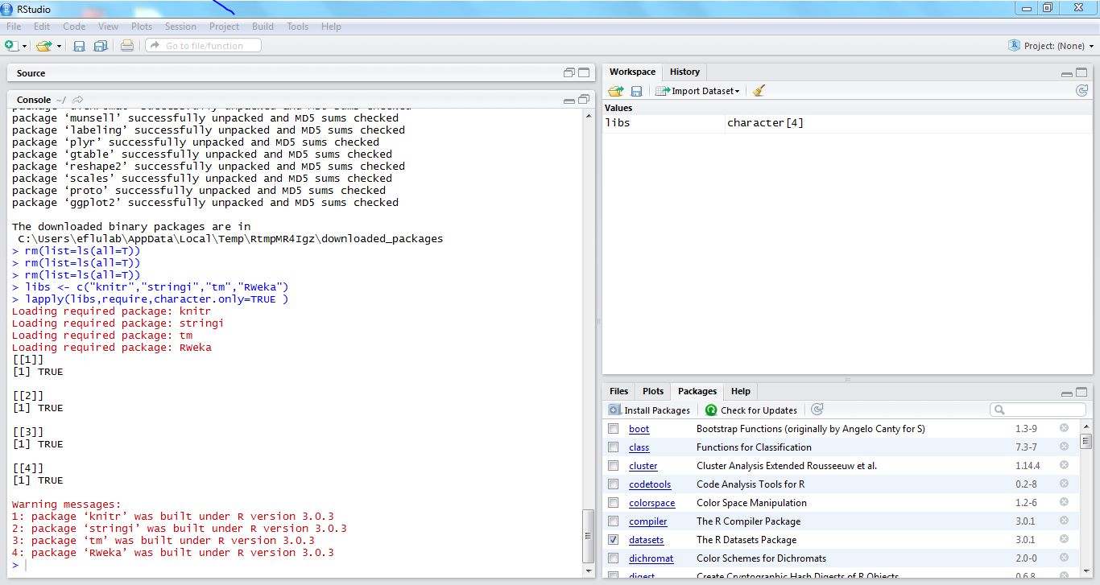

Slide 7
Statistical Estimators
Example:
Corpus: data from sakshi e-papers (Telugu text).
Lines count:
freqs2Lines <- length(freqs2)
[1] 980 (from training data).
Characters count:
freqs2Nchar <- sum(nchar(freqs2,type="chars"))
[1] 168949
Words count:
sum(stri_count_words(freqs2))
[1] 21734

Slide 8
Summary statistics :
stri_stats_general(freqs2)
Task: predict the next word of the trigram “జాతీయ గీతాన్ని ___”
Given the observed training data …..
Lines | LinesNEmpty | Chars | CharsNWhite
980 | 980 | 168948 | 147950

Slide 9
Data cleaning
text cleaning Prior to corpus Tokenization and for an adequate text mining data need to be cleaned in order to extract significant features.
Required package : tm
tm_map function:The cleaning function cleans as follow:
remove no alphanumeric
remove stop word
remove URLs
remove punctuation
remove no English words
remove numbers
strip white spaces Not all of them are necessary I will get back to this in next weeks.

Slide 10
Probabilistic Language Modeling
Manning & schutze. Statistical Natural Language Processing. 1999
A sentence W is defined as a sequence of words w1, …, wn
W = (w₁,w₂,w₃,...,w_{n})
The big (modeling) question is what is p(W)?
Well, we know (chain rule):
p(W) = p(w₁,w₂,w₃,...,w_{n}) = p(w₁)p(w₂|w₁)p(w₃|w₁,w₂)............. p(w_{n}|w₁,w₂,...,w_{n-1})
Probability of next word wn in a sentence is: P(wn |w1, …, wn-1)

Slide 11
a conditional probability
The probability of the whole sentence is: P(W) = P(w1, …, wn)
the chain rule of conditional probability
These counts & probabilities form the language model
[for a given document collection (=corpus)].
the model variables are discrete (counts)
only needs to deal with probability mass (not density)

Slide 12
N-gram Language Models
(n-1)^{th} order Markov approximation → n-gram LM:
p(W) = Π_{i=1..n} p(w_{i}|w_{i-n+1},w_{i-n+2},...,w_{i-1})
In particular (assume vocabulary |V| = ):
0-gram LM: uniform model p(w) = 1/|V|
1-gram LM: unigram model p(w)
2-gram LM: bigram model p(w_{i}|w_{i-1})
3-gram LM: trigram mode p(w_{i}|w_{i-2},w_{i-1})
4-gram LM: tetragram model p(w_{i}| w_{i-3},w_{i-2},w_{i-1})

Slide 13
N-gram functions
3 ngrams tokenization functions for unigrams,bigrams and trigrams Set the default number of threds to use, it is needed for ngram function.
options(mc.cores=1)
uniTokenizer <- function(t) NGramTokenizer(t,Weka_control(min=1,max=1))
biTokenizer <- function(t) NGramTokenizer(t,Weka_control(min=2,max=2))
triTokenizer <- function(t) NGramTokenizer(t,Weka_control(min=3,max=3))

Slide 14
Words, Tokens and N-Grams
tokenization
Text with words
Tokens
token n-gram (unigrams of words)
Bigrams
trigrams
ఆ రోజు చాలా మంది కి జాతీయ గీతాన్ని గురించి తెలియదు.
ఆ
రోజు
చాలా
మంది
కి
జాతీయ
గీతాన్ని
గురించి
తెలియదు
.
ఆ రోజు
రోజు చాలా
చాలా మంది
మంది కి
కి జాతీయ
జాతీయ గీతాన్ని
గీతాన్ని గురించి
గురించి తెలియదు
ఆ రోజు చాలా
రోజు చాలా మంది
చాలా మంది కి
కి జాతీయ గీతాన్ని
జాతీయ గీతాన్ని గురించి
గీతాన్ని గురించి తెలియదు
గురించి తెలియదు

Slide 15
Document TERM Matrix
Create Document Term Matrix and calculate frequencies using package tm and plot the 20 most frequent ngrams.
dtm <- DocumentTermMatrix(mycorpus, control=list(tokenize=uniTokenizer))
unifreq <- colSums(as.matrix(dtm))
barplot(tail(sort(unifreq),20),las=2,main="Top 20
unigrams",cex.main=1,cex.axis =0.75,horiz=TRUE)

Slide 16
Frequency of words unigrams bigrams
ఆ | రోజు | చాలా | మంది | కి | జాతీయ | గీతాన్ని | గురించి | తెలియదు
9 | 30 | 52 | 15 | 21 | 5 | 2 | 52 | 2
ఆ రోజు | రోజు చాలా | చాలా మంది | మంది కి | కి జాతీయ | జాతీయ గీతాన్ని | గీతాన్ని గురించి | గురించి తెలియదు
8 | 2 | 5 | 1 | 1 | 2 | 1 | 2

Slide 17
Trigrams
ఆ రోజు చాలా | రోజు చాలా మంది | చాలా మంది కి | కి జాతీయ గీతాన్ని | జాతీయ గీతాన్ని గురించి | గీతాన్ని గురించి తెలియదు
2 | 1 | 1 | 2 | 2 | 1

Slide 18
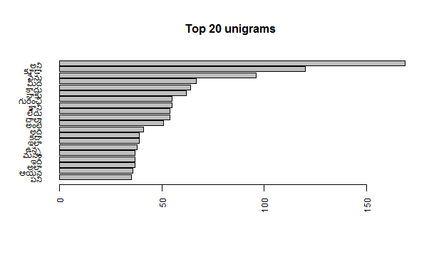
Plots

Slide 19
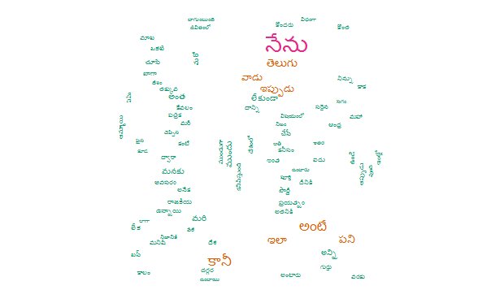
Word Cloud for 100 unigrams

Slide 20
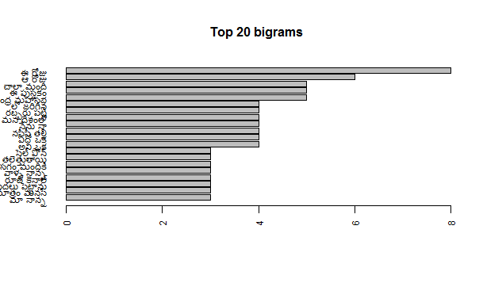

Slide 21
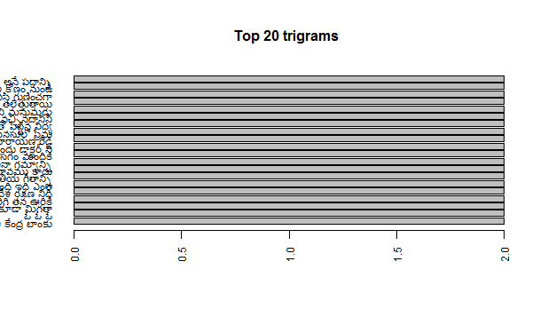

Slide 22
CONCLUSION AND NEXT STEPS:
I was really limited by my computer 2G RAM ,so i had to reduce the corpus size to the minimum possible. This issue should be re-examined ,may be more RAM or an online text exploration ,to be able to use a more data representative sample ,and do an adequate stemming and parsing ,also use a dictionary that can be passed to the DocumentTermMatrix as a control argument.
I’m planning to build a bigger corpus from the data, sampling at least the 40% of the total data.
The use of well designed functions may definitely help.
how to take into account smoothing when test set is not all covered by training set.
I expect to use n-gram models up to 4-gram , with a back off strategy
This code applicable to all languages(except English)

Slide 23
References
Quantitative corpus linguistics with R: a practical introduction.
Data Science Milestone Projects by apikou Abdelkader ESSODEGUI(for English text files):From Rpubs
Dr.Rahul Balusu case studies materials(special thanks)

Slide 24
Thanks ☺

